Slide 1











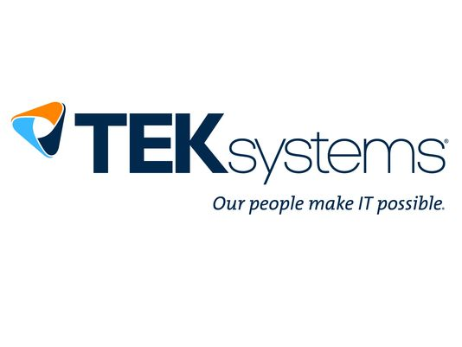


Thanks to our Sponsors!
Partners
Premier
Marquee
Prize
Next Session: Docker, the whole Docker, and nothing but the Docker @ 1:30pm

Slide 2
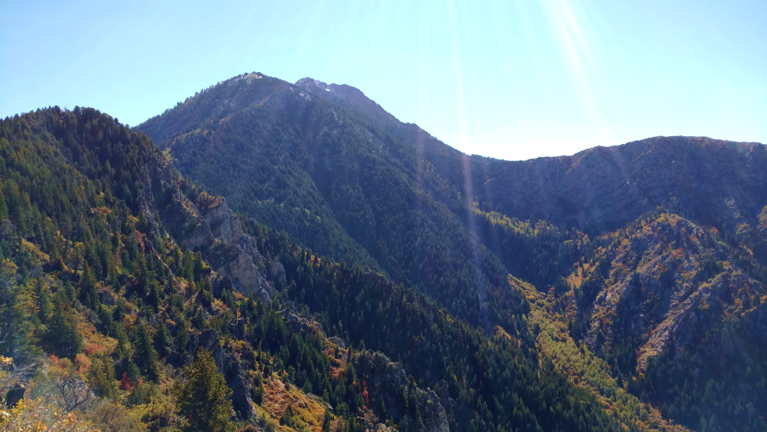
Docker, the whole Docker, and nothing but the Docker!
Big Mountain Dev and Data Conference
Notes:
The witness’ oath: I swear that the evidence that I shall give, shall be the truth, the whole truth and nothing but the truth, so help me God.

Slide 3

Truth and Fiction
There are a lot of people saying different things about Docker…
What is the truth?
http://www.soulation.org/freeatlast/2014/12/sharing-secrets-about-our-spouse.html
Notes:
First off, the truth. Our experience is with Linux and the RedHat distribution of docker. We have over a year-and-a-half experience with docker and 9 months of production experience with docker. We operate very simple and there are things we do not have any experience with like Kubernetes and AWS. Even so… we will try to keep this presentation as objective as possible.
Second, there is a lot of Fiction out there…
Some of it is misleading. Some is just plain false.
So what is the truth about docker? Well… I guess the best place to start is with the basics.
Likely your experience with docker will be different than anyone elses.

Slide 4
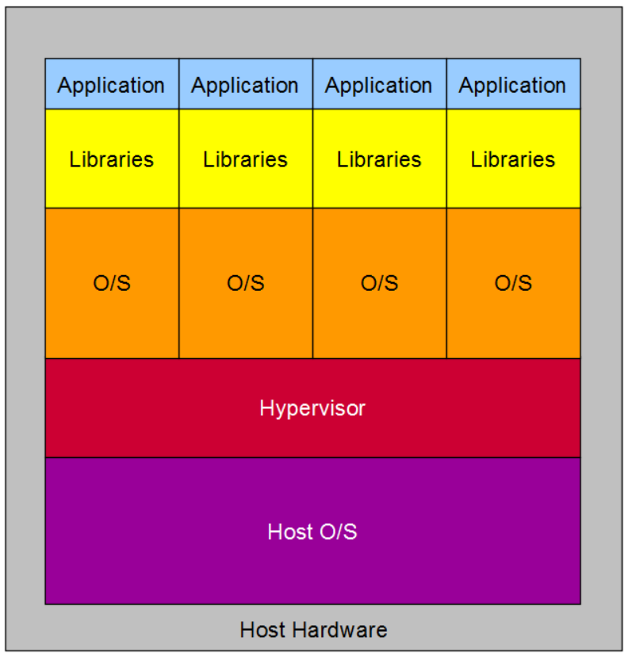
I Know What a VM is…
Dedicated Hypervisor and Hypervisor Services
Operating System and Libraries
Daemons and Applications
Each application requires installation and configuration.
Notes:
Let’s start with something that should be familiar to all of us by now. Virtual Machines, also known as VMs.
Traditionally each VM is loaded up with one application or a heterogeneous suite of applications. Homogeneous applications are normally spread individually across VMs.
Each VM has a full O/S and set of libraries each.
The hypervisor stands between each VM and Host O/S and provides or mediates most or all of the services required by each VM.
The VM allowed us to run multiple ‘machines’ on a single computer.

Slide 5
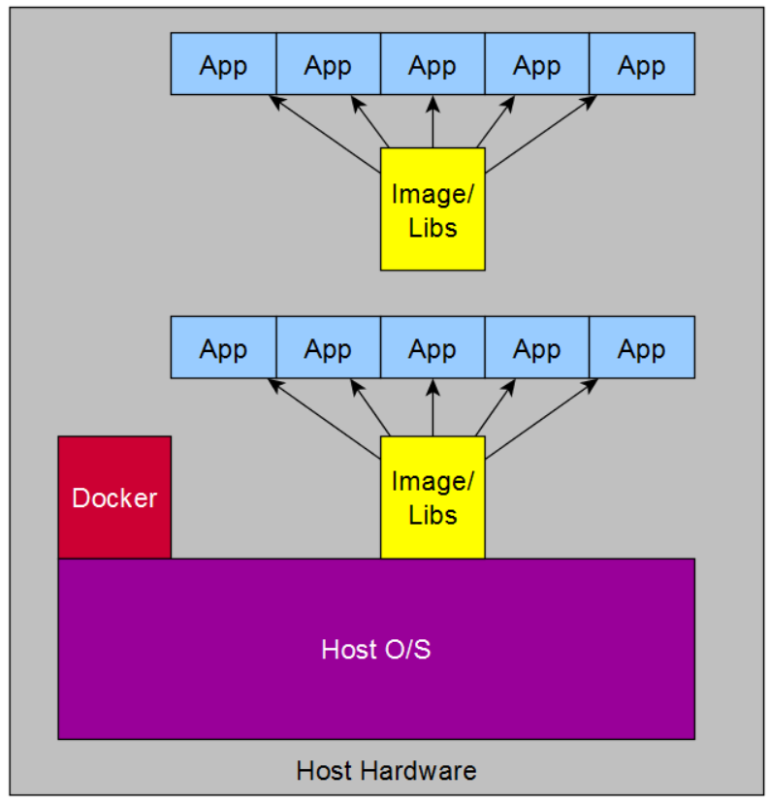
What is a Container?
Shares O/S with host
Shares Libraries with other containers
More apps per server
Containers created very fast
Application already installed
Notes:
OK, now docker. First thing to remember, docker is not a VM. Keep saying that to yourself as we go through this presentation.
You can see by the diagram, simplistic as it is, There is a distinct lack of O/S at the container level. And what else is weird, it seems that some containers share libraries.
Also, Docker is only involved when a container is started and when it is stopped. Other than that it is out of the way and provides no mediation between O/S and App.
Docker is different indeed.
Whats more, containers start with a single application. The containers do not provide any daemon services, and they are typically focused on a single purpose.

Slide 6
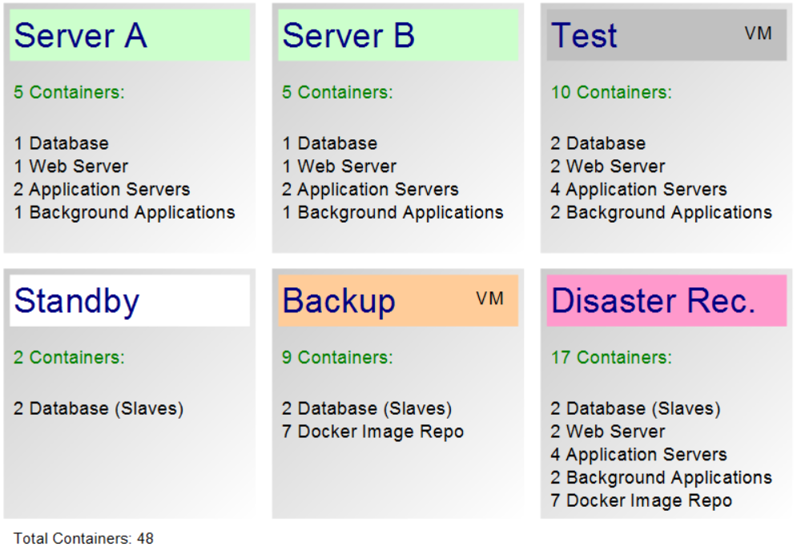
Our Background
How we got involved with Docker
Research
Opportunity
Deployment
Notes:
The first thing we thought about docker was that it was “interesting, but I wouldn’t put it in production.” Our first planned project with it was to use it for our test system for testing our code and provide a way to run multiple test environments at once..
We tinkered with it for a few months trying to figure it out. Got lost a few times and then finally go to “Ah Ha!”
The thing that really changed our minds was a sudden security project that demanded that the application be logically separated for other projects. We were faced with the decision: Spend $11,000 on one server or spend around $100,000 to do single installations or VMware. $11,000 dollars seemed the right choice. So, now our production environment is 100% docker.
This is a general layout of how we have used docker. Our test machine also runs multiple docker containers.

Slide 7
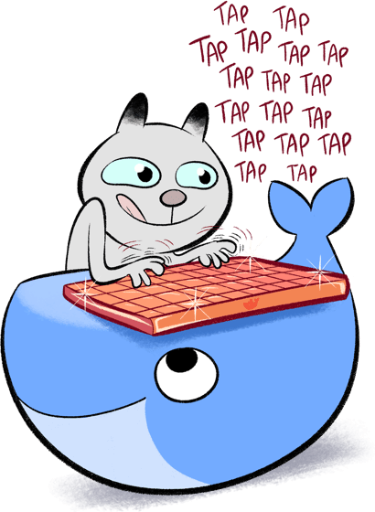
Docker Topics
Distribution Differences
Repositories
Images
Volumes
Networking
Containers
Security
https://www.docker.com/sites/default/files/catkeyboard%402x-min.png
Notes:
These are some areas of docker that we will be covering in this presentation.

Slide 8
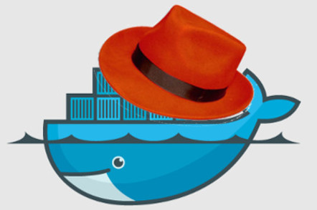
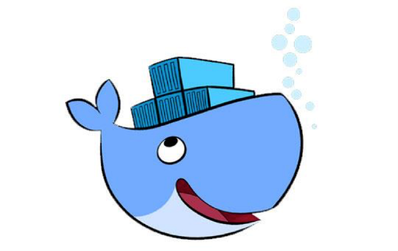
Distribution Differences
Community vs. Enterprise
docker build –v
(fedora/redhat/centos only… as far as we know)
Shocking revelation:
https://www.theregister.co.uk/2014/08/18/docker_kicks_kvms_butt_in_ibm_tests/
Not all whales are the same…
https://www.linkedin.com/pulse/docker-training-columbia-md-brian-keyes/
Notes:
When we first started investigating docker, we assumed that all docker implementations were equal. Well… that did not turn out to be the case. We were using the docker distributed by RedHat. It has a flag on the build command that allows the attachment of a host directory from which data, programs, and libraries can be copied into the image. As we talked to others who were using other implementations, we were confused why they were having issues with including files into their images and suggested that they use the –v flag we had found. I’m sure that they were quite frustrated to find that their implementation did not have it. Turns out it was a RedHat thing. Hmmm…

Slide 9
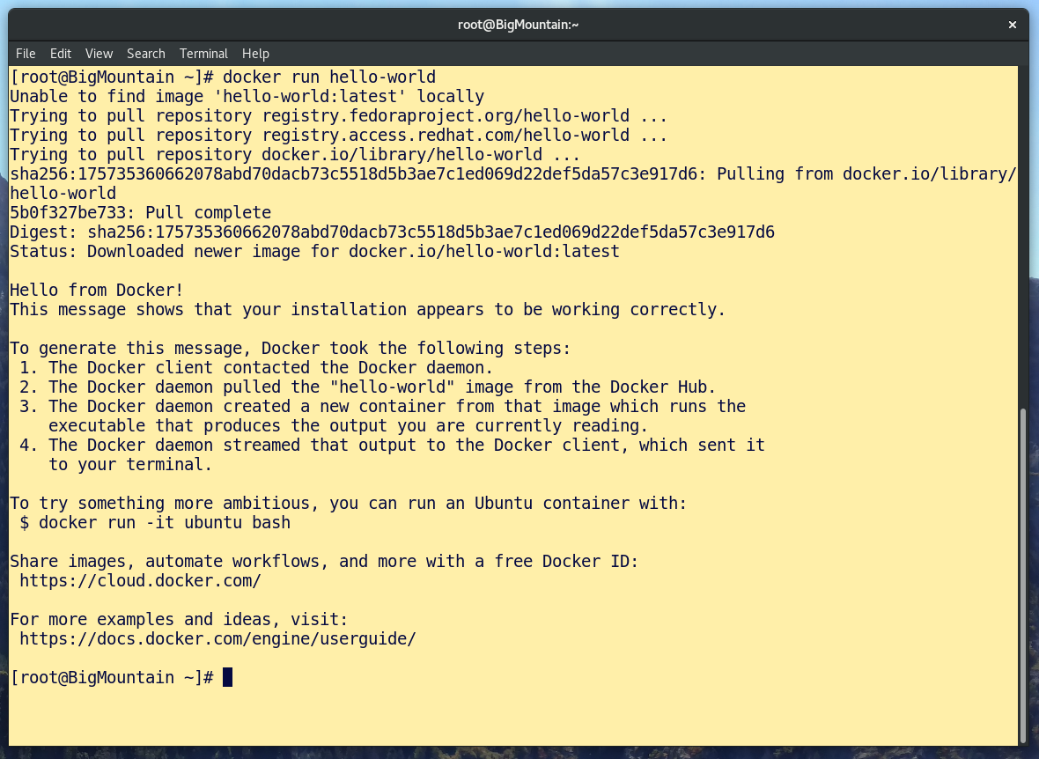
Docker installation
Package Manager Installation
dnf install docker
yum install docker
apt-get install docker
Or you can install the one on Docker web site.
“Hello World”
Notes:
Docker is available for most linux flavors through the package management utility or by following the instructions on docker.com for your O/S.
Once installed, you start the docker daemon and then run the hello-world image to show that docker is working.

Slide 10
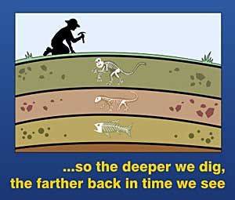
Image Storage Structure
Image Archaeology
Layers
Base Image Layers
Provided by someone else
May satisfy a simple deployment
Layers Added by You
Customization for your unique needs
Satisfies complex requirements
Read Only!
Successive layers cannot change files in previous layers
Containers cannot change image files
Copy-on-Write
http://www.prehistoricplanet.com/articleimgs/48.jpg
Notes:
Containers are based on images. Images form the bulk of the container’s storage. Images store libraries and software installation. The next slide is an illustration of layers.

Slide 11
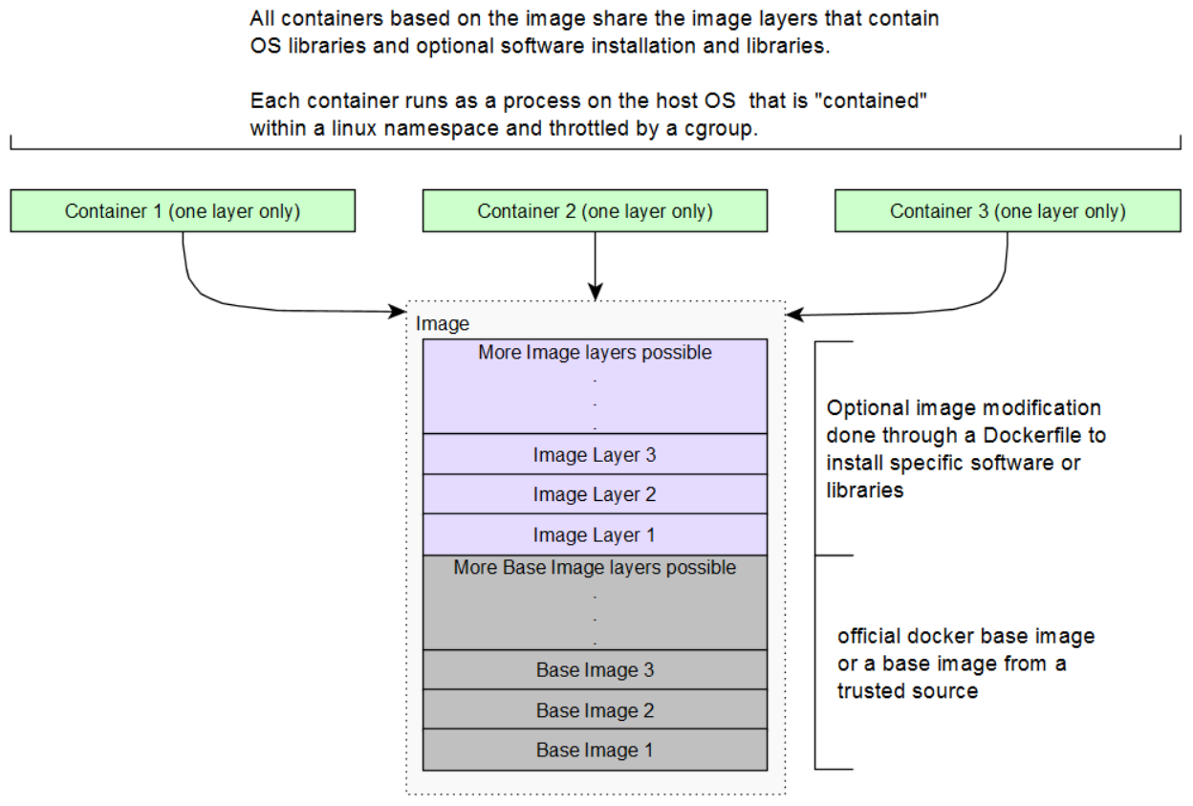
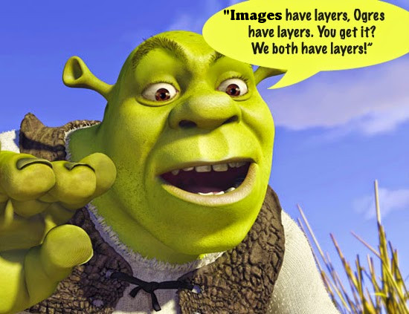
Layers
www.roblox.com/games/149426952/Ogres-are-like-onions
Notes:
As a container accesses files, it first searches its own layer. If it is not found, it then searches the image layers in reverse order until the file is found. The container is not allowed to modify any file in the shared image.
If the container modifies the file, first the file is located and then copied into the container layer. The directory structure is maintained, but the image file is essentially overridden by the container file. This functionality is known as Copy-on-Write or COW.

Slide 12
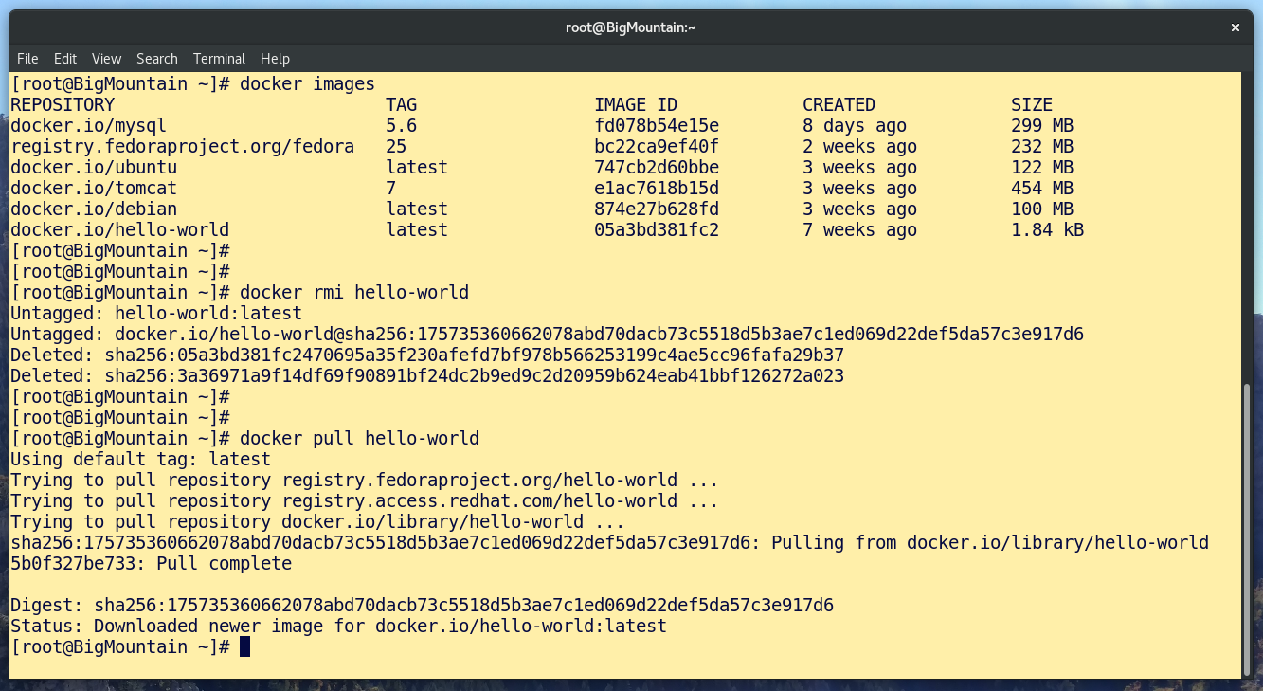
Image commands
Notes:
Each docker server maintains a local repository. Images are pulled to and pushed from it to other repositories.

Slide 13
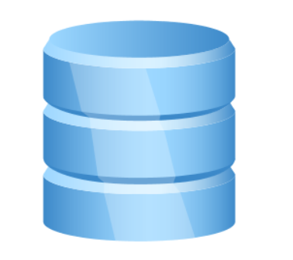
Volumes
Volumes
Container (old school)
docker run --volume-from {other_container}
Build
VOLUME {container_path}
Named
docker volume create
docker volume ls
docker run –v {named_volume}:{container_dir} {image_name}
Host
docker run –v {host_dir}:{container_dir}
Notes:
Before other kinds of volumes were available, the only way to add additional space was through a Container Volume. To my knowledge, that is no longer an accepted practice.
Build Volumes are written into the image by the Dockerfile to be created when the container is run and managed in the docker directory (/var/lib/docker).
Named Volumes are created ahead of time within the docker environment and attached to the container with the RUN command and are also manage in the docker directory (/var/lib/docker).
Host Volumes are stored on the host machine outside of the docker directory and are attached to the container with the RUN command.
There are also third-party drivers that can provide container storage that can be accessed from multiple hosts.

Slide 14
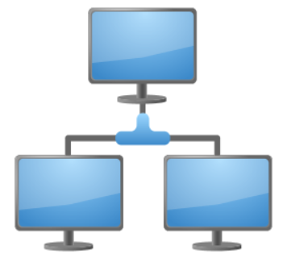
Networking
docker network create
docker network ls
docker run –p
Used to expose container ports
Used to gain access to host nics and ports
docker run –network={network name}
Used to isolate containers
Notes:
Docker networks function on the border between the container or a collection of containers and the operating system. Port assignment includes connecting a specific container, not the network, to a network interface that is connected to the LAN.
Containers can be given their own IP address, or they can share an IP address with other containers. If multiple containers have the same operating port, ports can be mapped to different port numbers.
As a matter of good practice, use of docker0 should be avoided. Create docker networks that provide the right level of isolation between sets of containers. One of the IP addresses on the host should be assigned for administration and should not be used for containers. A collection of IP addresses should be assigned for container use. The ip addresses should be limited in functionality to the needs of the containers by a firewall or iptables.

Slide 15
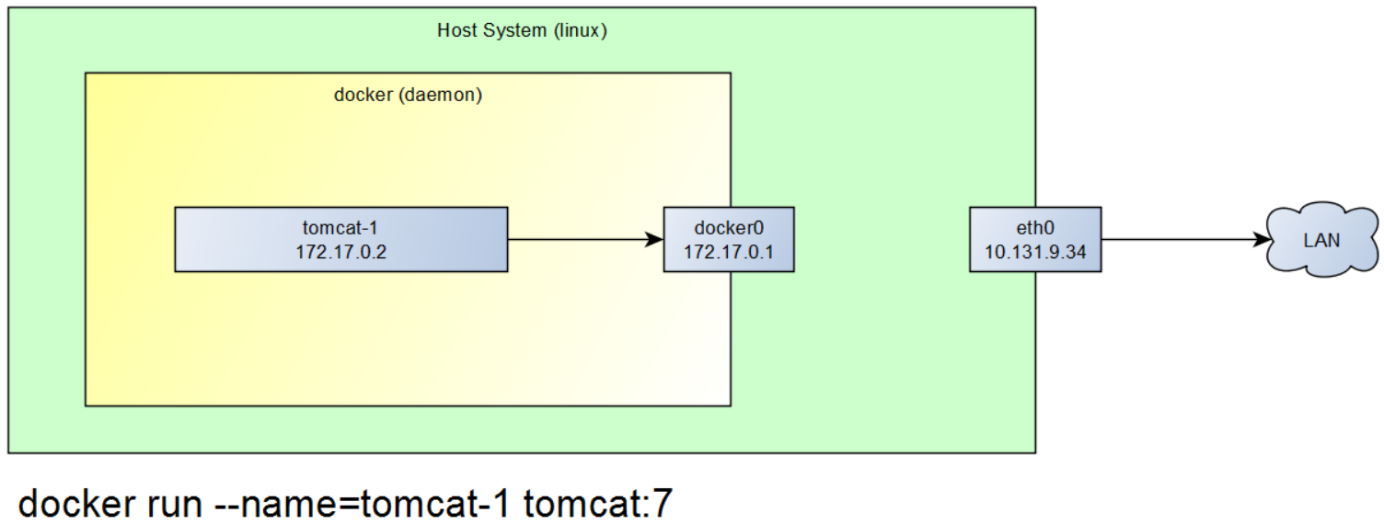
Networking
Notes:
The simplest network connection is docker0 (172.17.0.1). Even with a network connection, a container cannot communicate without exposing container ports. Container ports can be exposed in the Dockerfile and/or by the docker run command. That being said, the docker run command is the only thing that can connect the container to an IP address.

Slide 16
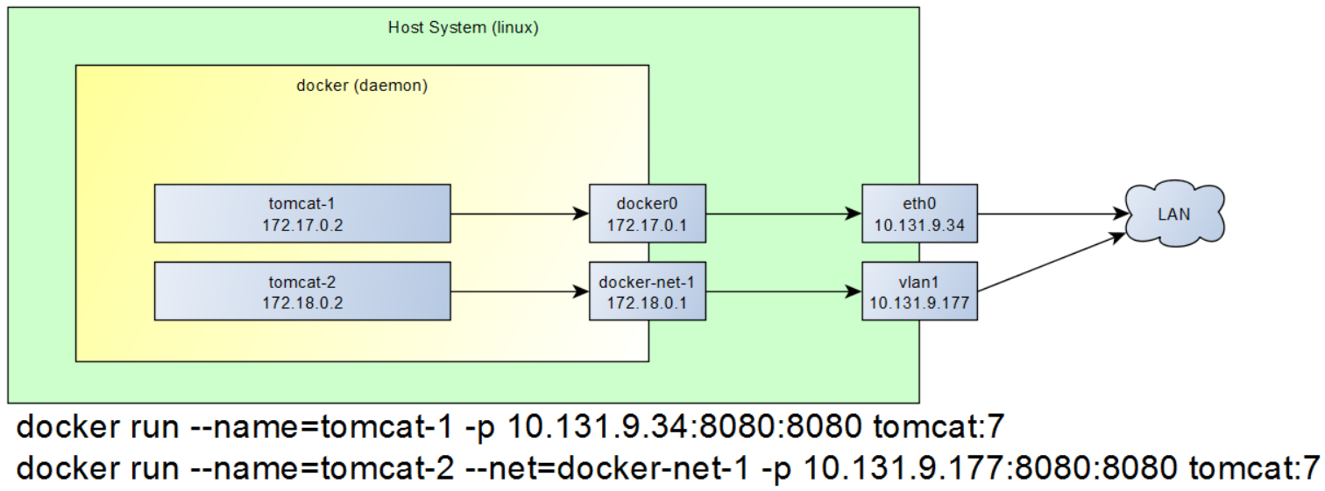
Networking
Notes:
Scenario 1: If a container needs to communicate with another container in the same docker network on port 3306, and nothing outside of that network really needs that access. The EXPOSE command in the Dockerfile can provide access to the port without giving access to an outside interface.
There are a multitude of other scenarios that can be satisfied that allow or restrict access to containers and their ports.

Slide 17
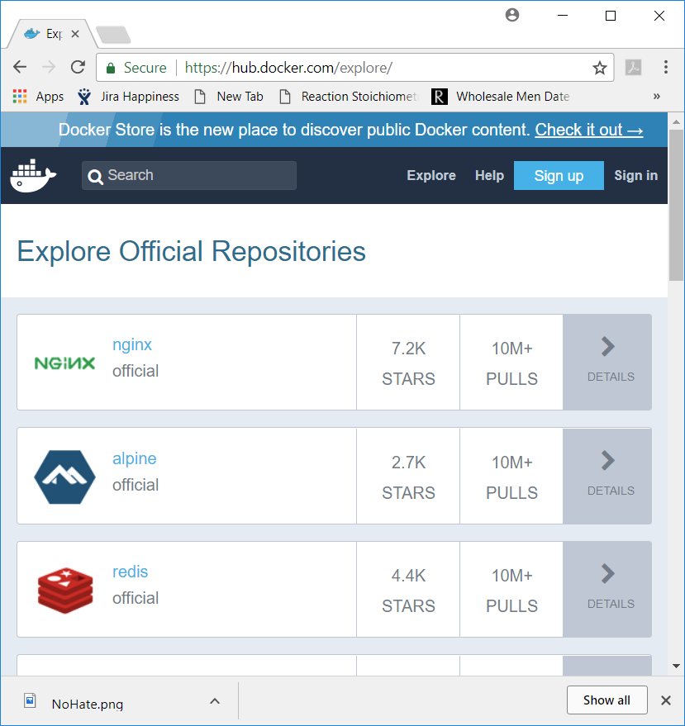
Repositories
Docker Hub (dockerhub.com)
Official vs. Unofficial
Accessible anywhere in the world
3rd Party (redhat, others)
Images created by vendor
Accessible by account/subscription
Your Party!
Your personal image library
Accessible to you only
docker search
Find by keyword in repository
docker pull
Check out an image
docker push
Commit an image
Notes:
Repositories are where images, which form the basis of containers, come from. Images range from merely flavors of an O/S to fully ready-to-run applications. You can take any image and make your own image by adding your specific modifications to it.
Docker has a repository container available on dockerhub.com
This is the repository that we use at MTC…
Harbor Repository: https://github.com/vmware/harbor/

Slide 18
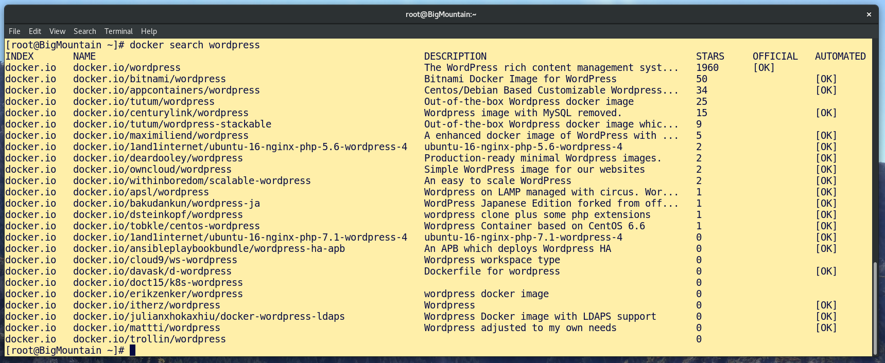
docker search wordpress
Notes:
Searches, by default, will search docker hub for the keyword. Images that are official are marked as such and are considered trustworthy. Other non-official images are submitted by industry and the community and should be carefully considered before using.

Slide 19


Container Strategy
Cattle
Self Contained
Self Configuring
Easily Replaced
Don’t Touch
Pets
Not entirely self contained
Requires additional configuration
Potentially difficult to replace
Interaction with it is not a big deal
OpenClipArt.org
OpenClipArt.org
Notes:
The way you use docker should influence how you choose to configure the images and containers. If you intend to run a particular application at significant scale, you will be more inclined to use the cattle design. If an application will not run at significant scale, then the pet design or some hybrid of cattle and pets may be of consideration. All applications do not have the same requirements or needs and are not run the same way, therefore, the consideration for cattle or pets should be made at the application level.

Slide 20
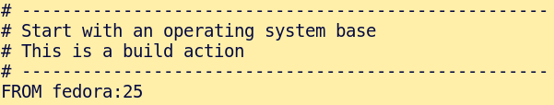
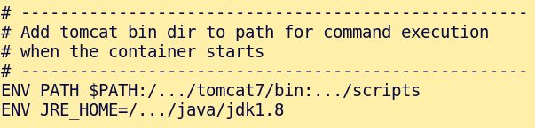
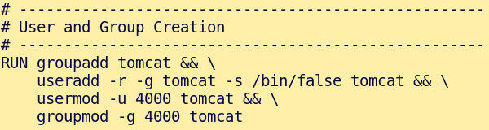
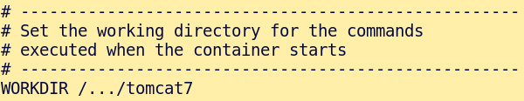
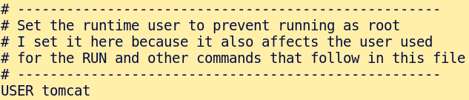
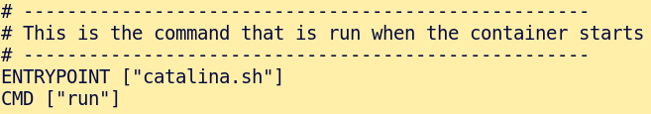
Dockerfile
FROM
RUN
USER
ENV
WORKDIR
ENTRYPOINT/CMD
Notes:
ENTRYPOINT
Command form is preferred.
Shell form runs as a ‘sh –c {}’ disadvantage is that the process will not receive signals like sigterm to promt the software to exit on container stop. Although running exec or gosu (linux commands) first, this problem is fixed.
Cannot be overridden by substituting the command on the RUN command
But can be overridden with the –entrypoint flag on the RUN command.
CMD is similar in function. However, ENTRYPOINT is evaluated first when both ENTRYPOINT and CMD are present. In this case CMD supplies additional arguments to ENTRYPOINT.
-
(https://docs.docker.com/engine/reference/builder/#shell-form-entrypoint-example)
Dockerfile is very much like an installation/configuration procedure document… just automatic instead of manual.
Although containers are started as a single process… they don’t necessarily stay that way.

Slide 21
Build Image
docker build –t {imagename}:{version} {work_dir}
Example: docker build –t tomcat:7.1 /u1/tomcat/build

Slide 22
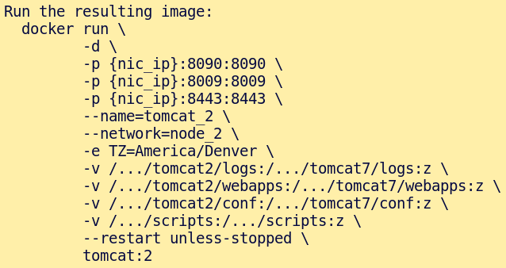
Running Containers
docker run
Container storage limit 10Gb
docker rm –v
Removing a container
Interacting with the container
docker ps
docker exec
docker attach
Notes:
The run command…
A container is limited to 10Gb of storage. This can be changed in the docker settings, but changing the limit is discouraged. Instead, volumes are recommended.
Container storage is a single layer. When a container is created it is empty. The container runs using all the programs and libraries included in the image. As the container runs, logs or changed files are written to its storage. Containers cannot change the image. They can copy the file from the image and store a modified version of it in the container storage. This is referred to as Copy-on-Write storage.

Slide 23
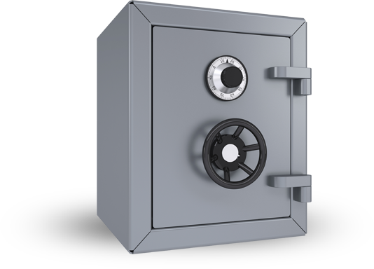
Security
Host machine only runs docker… nothing else.
Set appropriate host/user permissions
Isolate root
Isolate Container nics (block ssh and other services)
Never run container/application as ‘root’
Build image with only what is needed… no more.
Set appropriate file permissions
One container to a purpose
Expose only the ports needed
CIS (Center for Internet Security) standards for Docker
https://www.cisecurity.org/cis-benchmarks/
http://bostonlockandsafe.com/safes/2049990
Notes:
Keeping the host function limited to running only docker prevents unwanted application privilege escalation. Any application on the host requires a lot more administration to prevent privileged access.
Docker Security Benchmark available at CIS
https://www.cisecurity.org/benchmark/docker/
Obtaining the benchmark requires a form entry with email address and name. The document is quite comprehensive. There are also benchmarks available for the host operating system and a array of major applications.
https://www.cisecurity.org/cis-benchmarks/

Slide 24
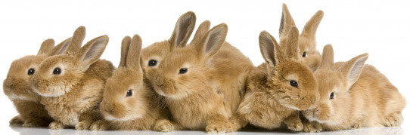
Stuff Not Covered
Docker Swarm (scaling up)
Docker Compose (functional grouping)
Kubernetes (scaling up)
3rd Party Volume Drivers (scaling up)
3rd Party Network Driver (scaling up)
http://rebloggy.com/post/animals-cute-history-napoleon-napoleon-bonaparte-bunnies-rabbits-hunting-napoleo/74128114047
http://rebloggy.com/post/animals-cute-history-napoleon-napoleon-bonaparte-bunnies-rabbits-hunting-napoleo/74128114047
Notes:
What we have talked about so far concerns docker and docker only. Many of the products listed on this page concern productions of significant scale. When containers are used in sufficient scale, the rules of deployment change a bit. Efforts to make sure containers are cattle instead of pets become more important.

Slide 25
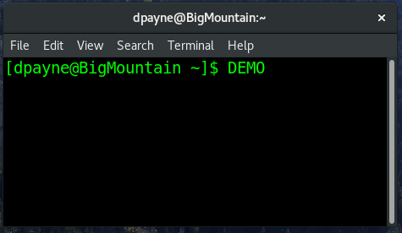
Demo
Hello World
Container Shell
Notes:
Test VM: 192.168.5.102
Commands:
docker images
docker ps
docker stop mtctomcattest1
docker rm –v mtctomcattest1
docker pull tomcat:latest
vi /u1/ods/tomcat/runscripts/runTomcatBigMtn1.sh
If Time:
docker exec –it –u root mtcdbtest bash

Slide 26
Contact Info
Presentation: https://github.com/sdpippin/BigMtnDocker
Any Further Questions:
Dennis Payne (dennis@mtctrains.com)
Scott Pippin (spippin@mtctrains.com)
Useful Links:
Docker Enterprise https://www.docker.com/enterprise-edition#/platform
Docker Enterprise Pricing https://www.docker.com/pricing
http://rebloggy.com/post/animals-cute-history-napoleon-napoleon-bonaparte-bunnies-rabbits-hunting-napoleo/74128114047
Notes:
What we have talked about so far concerns docker and docker only. Many of the products listed on this page concern productions of significant scale. When containers are used in sufficient scale, the rules of deployment change a bit. Efforts to make sure containers are cattle instead of pets become more important.

